Slide 1
OBJECT ORIENTED PROGRAMMING bsse 2nd semester

Slide 2
Presented by
Khadija Ashraf (24-se-040)
Dua Ghafoor (24-se-082)
Muhammad Hassam (24-se-046)
Saad Faisal (24-se-115)

Slide 3
Title of project Smart recipe book

Slide 4
Objectives
This project aims to achieve several key educational and practical goals:
Reinforce fundamental Java concepts, including classes and objects, abstraction, inheritance, polymorphism, and encapsulation, by applying them to real-world scenarios.
Showcase the design and implementation of a multi-class application using object-oriented programming principles.
Demonstrate effective data management through file input/output operations, enabling us to understand how to read from and write to text files.
Illustrate the development of graphical user interfaces (GUIs) using Java Swing, incorporating panels, layouts, buttons, and text fields to create interactive applications.
Teach us how to handle exceptions using try-catch blocks, ensuring robust error handling and user-friendly feedback.

Slide 5
Programming concepts used
This project strongly demonstrates the main principles of object-oriented programming.
Classes and Objects
Abstraction
Polymorphism
Inheritance
Encapsulation
File handling
Exception Handling with try-catch
GUI Usage and Features

Slide 6
GUI OUTPUT

Slide 7
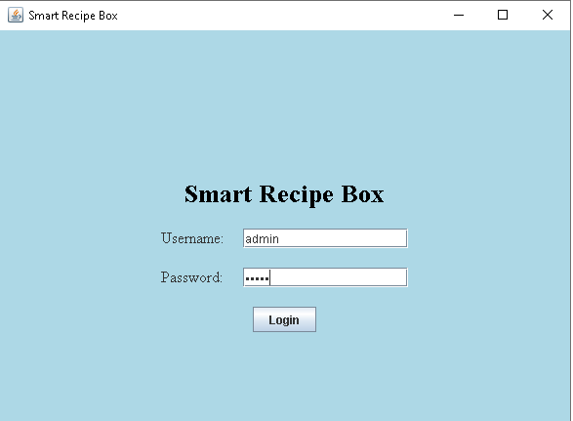
LOGIN SCREEN

Slide 8
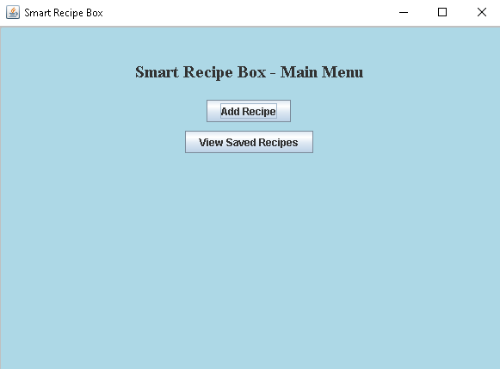
MAIN MENU

Slide 9
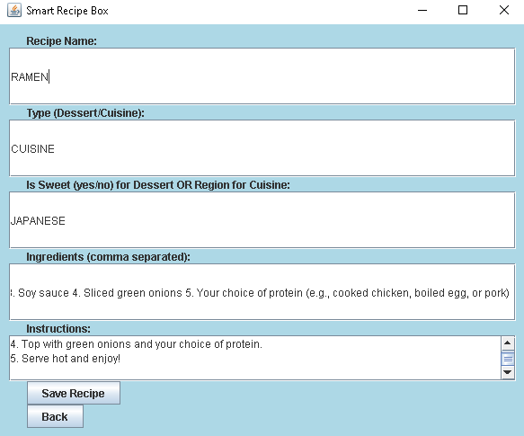
ADD RECIPE PANEL

Slide 10
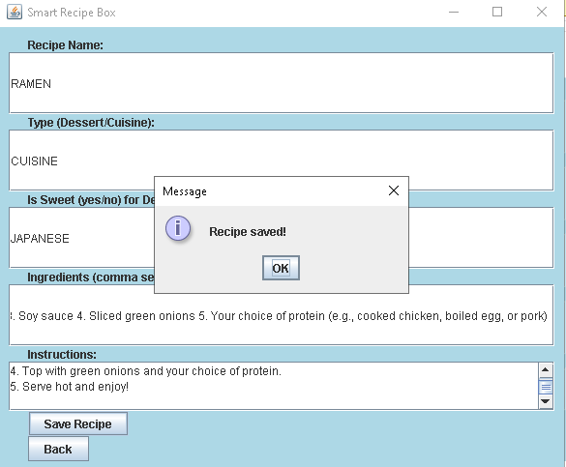
RECIPE PANEL

Slide 11
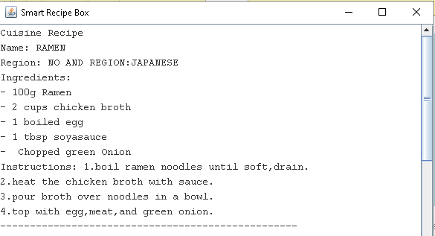
View saved recipe panel

Slide 12
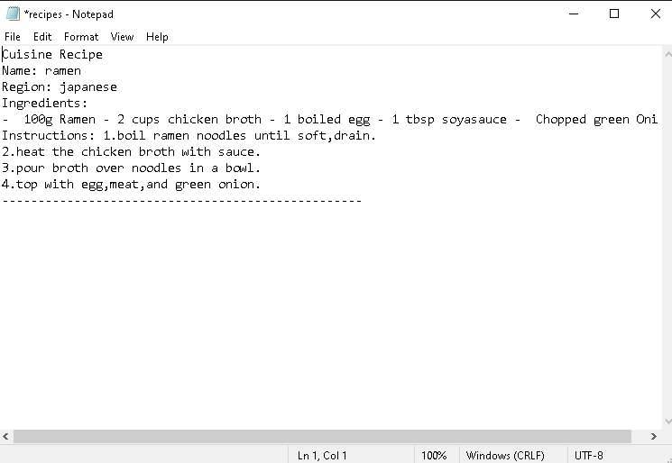
File (recipes.txt)

Slide 13
Future enhancements
User Account Management
Add dynamic registration and login
Personal recipe collections per user
Search and Filter Features
Search by ingredient, cuisine, recipe type, or dietary preference
Use dropdowns and checkboxes for filters
Graphical Recipe Display
Show recipes in card layouts with styled fonts and borders
Allow users to upload dish images
Database Integration
Replace text file with database (e.g., SQLite/MySQL)
Store user and recipe data in tables
Enable better data organization and multi-user support
Edit and Delete Recipes
Add features to modify or remove saved recipes
Export and Print Options
Export recipes to PDF
Allow direct printing for kitchen use

Slide 14
Conclusion
The Smart Recipe Box project successfully demonstrates the integration of core object-oriented programming concepts such as abstraction, inheritance, polymorphism, and encapsulation in a real-world application. Through the use of classes like Recipe, Dessert, and Cuisine, we were able to create a scalable and extensible design that organizes recipe data efficiently. The implementation of a graphical user interface (GUI) using Java Swing made the application more user-friendly, with features such as login authentication, styled components with borders, readable fonts, and clearly structured input sections. Additionally, file handling was incorporated to ensure that user-added recipes are persistently stored in a text file, even after the application is closed. The use of the try-catch mechanism helped in managing potential input/output errors, making the application robust and reliable. From a learning perspective, this project not only enhances students' practical skills in Java programming but also introduces them to the real-time challenges of software design, user interaction, and data storage. With proposed future enhancements like database support, user accounts, search filters, and mobile versions, the project lays a strong foundation for developing a fully functional, intelligent recipe management system.

Slide 15

Thank you

